Slide 1
ArcGIS Earth Essentials
Basics of ArcGIS Earth. MUST be viewed as a slideshow to see the process flow. Run it Auto or with the timings turned off. (Slide Show | Use Timings)
Ref: https://learn.arcgis.com/en/projects/get-started-with-arcgis-earth/lessons/explore-the-world-with-arcgis-earth.htm
ACKNOWLEDGEMENT
This presentation is derived from the above page, with navigation and explanations added to simplify the learning process. While the presentation in its entirety remains the property of NCI, the knowledge base and some graphics in the above URL are owned by ESRI
Copyright © 2019 by National Computational Infrastructure, Canberra, ACT, Australia. Author: Dr. Arapaut V Sivaprasad.
15 January, 2018

Slide 2
INTRODUCTION
ArcGIS Earth can display layers from an online service such as GSKY. Though currently it has errors at the GSKY server end, it is nevertheless calling the GSKY server URL for data. The error is different from that seen with QGIS, in that the GSKY server software lacks certain libraries. Finding and including the missing libraries may lead to either a working version or further errors.
SYSTEM REQUIREMENTS
Windows 7 to 10 (64 bit [EM64T])
Microsoft .NET Framework 4.6.1
Microsoft Visual C++ 2015 Redistributable Update 3.
Direct3D feature level 9_3
Default: DirectX 11 hardware support
Falls back to DirectX 11 software rendering if hardware support is not available
CPU speed: 2.2 GHz or higher
Hyper-Threading Technology (HTT) or multicore
Memory/RAM: 2 GB or higher.
Display: 24-bit color depth.
Screen resolution: 1024x768 or higher
This presentation is an evolving document to learn ArcGIS and incorporate GSKY. Firstly, a basic tutorial on how to add map and layers will be shown. Adding layers from public repositories, local files and online URLs (the latter is for GSKY) will be demonstrated.
AUTHORISATION
ArcGIS Desktop Advanced_Single User Licence
https://arcgis.anu.edu.au/arcgis-pro-installing.html
Downloads:
https://wattlecourses.anu.edu.au/course/view.php?id=21946
Activating ArcGIS Pro on an ANU desktop computer
Activating ArcGIS Pro on a laptop
ArcGIS Online account
https://ausnatuni.maps.arcgis.com/
OBJECTIVES
Learn the basics of ArcGIS Earth (“AE”).
Find out whether it is the client we need for GSKY.
Get layers added to AE from GSKY.
Prepare tutorials on the usage.
Next: Start the tutorial

Slide 3
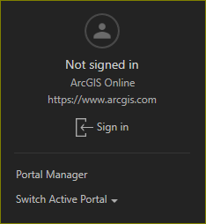
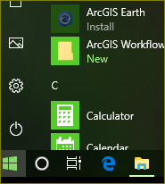
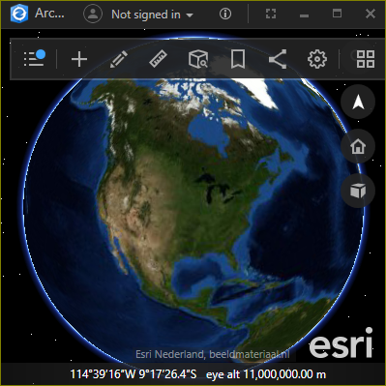
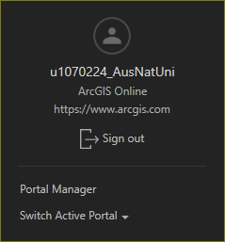
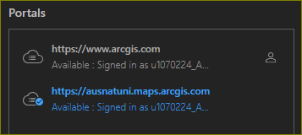
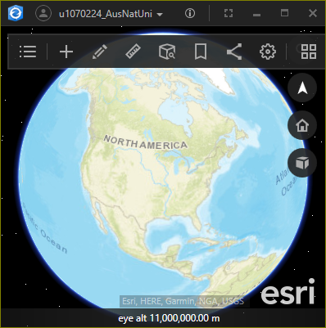
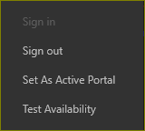

Software Installation and Setup
The AE software is included in the ArcGIS Desktop licence. However, it does not get installed automatically. To install on Windows 10, do the following.
Start | ArcGIS Earth
Install and run
Sign in with ANU licence
Set an active portal
Next: Start the tutorial

Slide 4
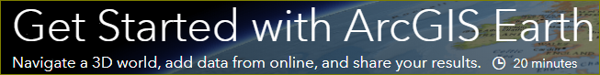

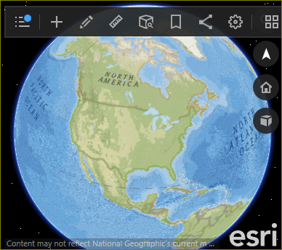

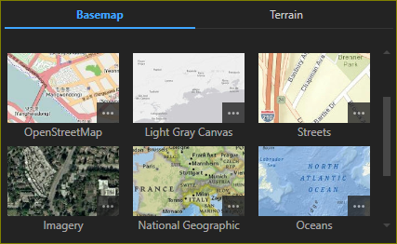
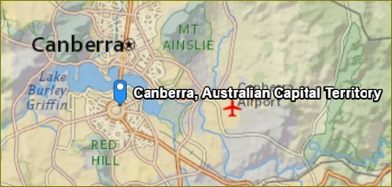
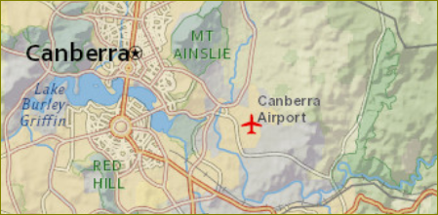
Basemap and Explore
In this lesson, you'll explore the world with ArcGIS Earth, a streamlined desktop application that displays 2D and 3D data from around the globe. You'll add map layers from files and the ArcGIS Living Atlas of the World, then pan, zoom, and tilt to view them. Your exploration will encompass Paris, Mount Everest, San Francisco, and several other locales. When finished, you'll share your map data via email.
Change the basemap and terrain
Zoom to a location
Next: Bookmark and Play

Slide 5
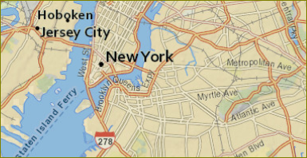
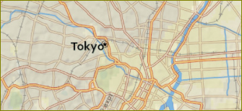
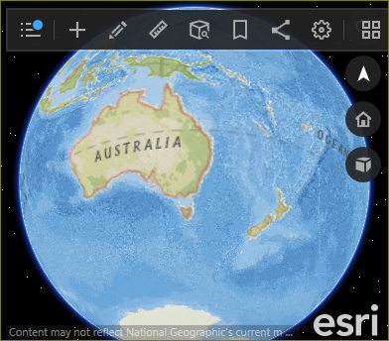

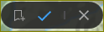
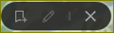
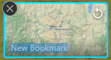
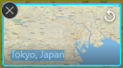
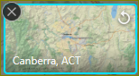
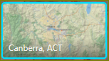
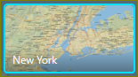
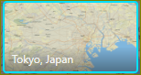



Bookmarks
Bookmark the current location.
Find two other locations and bookmark.
Cycle through bookmarks
Delete bookmarks.
Zoom out to home.
Next: Add data from living atlas

Slide 6
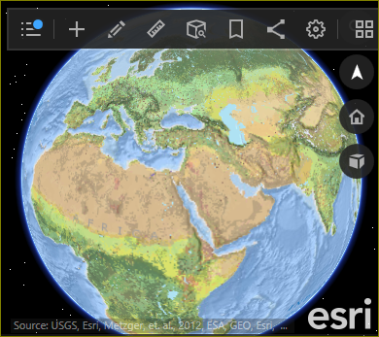

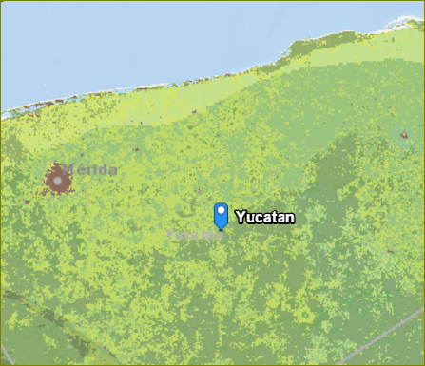
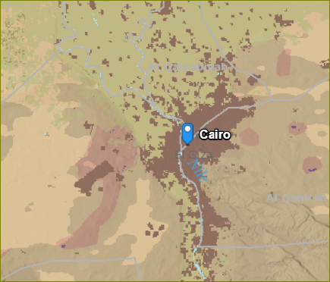
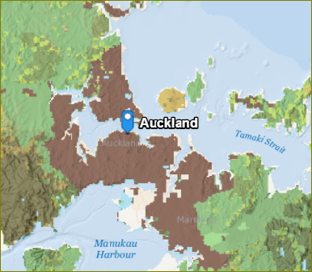
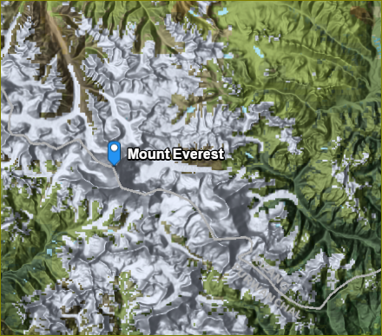

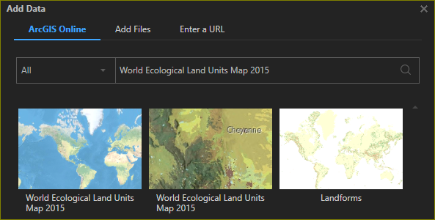


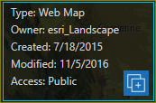
Add data from living atlas
Add a world ecological data layer.
Zoom to various places.
Next: Add data from files

Slide 7
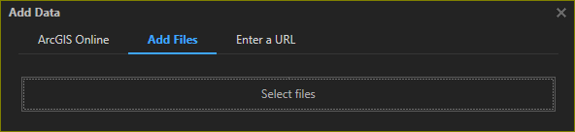
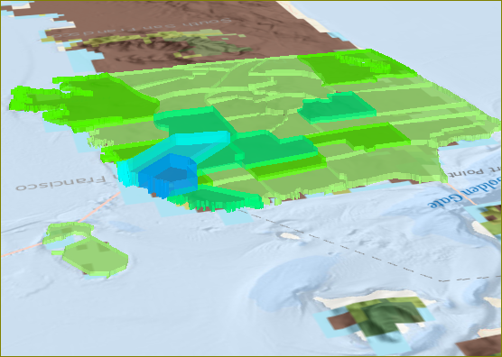
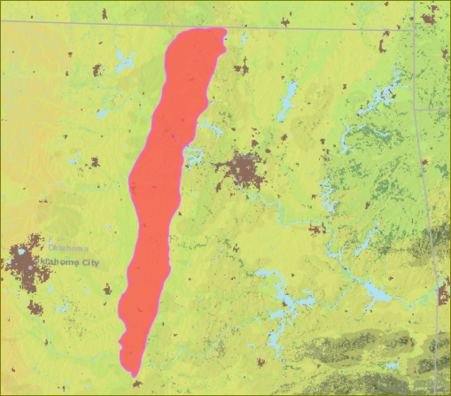
Add data from files
Add a KMZ file.
Add a SHP file.
Next: Add data from online

Slide 8
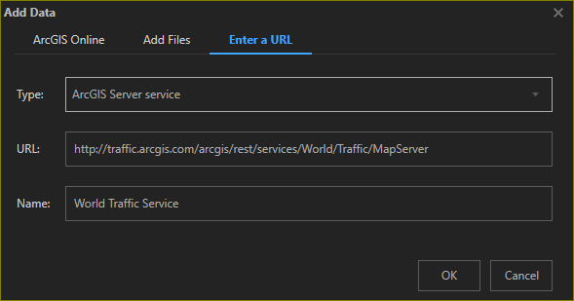
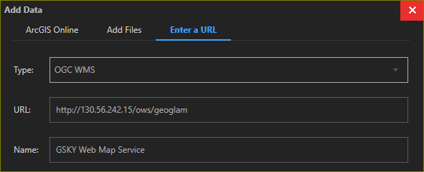
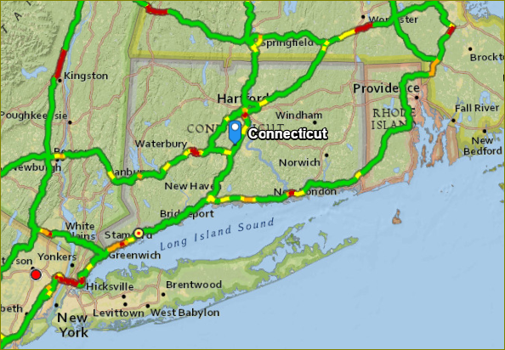
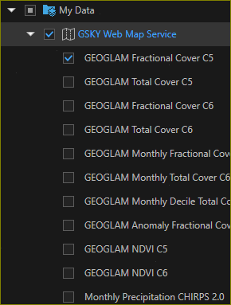
Add data from online
Add a World Traffic Service.
Add GSKY Service.
End of the Tutorial. Next: GSKY debugging

Slide 9






Acknowledgements

